Slide 1
UNIT IV – SDN Application and Use Case
UNIT I – SESSION 1
SESSION 6
  SDN vs. P2P/Overlay Networks
  SDN Applications - Reactive versus Proactive Applications
  Analysing Simple SDN Applications
  Reference: Ref. 1, Ch.8.8, 10.2, 10.3

Slide 2
P2P/Overlay Networks
P2P/overlay networks resemble the overlay networks
P2P/overlay network overlaid over the public Internet without concern or knowledge of the underlying network topology.
Such networks comprise a usually ad hoc collection of host computers in diverse locations owned and operated by separate entities, with each host connected to the Internet in either permanent or temporary fashion.
The peer-to-peer (hence the name P2P) connections between these hosts are usually TCP connections.
Thus, all of the hosts in the network are directly connected.
Napster is the earliest well-known example of a PTP/overlay network.

Slide 3
SDN vs. P2P/Overlay Networks
P2P/overlay networks | SDN via hypervisor-based overlays.
Need for coordination between P2P/overlay devices (peers) | Require coordination of controllers
At scaling, Coordination and control occur in distributed fashion | At scaling, Coordination and control occur in distributed fashion

Slide 4
Reactive SDN Applications
The communication between the switch and the controller will scale with the number of new flows injected into the network.
The switches may often have relatively few flow entries in their flow tables, since the flow timers are set to match the expected duration of each flow in order to keep the flow table size small.
This results in the switch frequently receiving packets that match no rules.
Those packets are encapsulated in PACKET_IN messages and forwarded to the controller and thence to an application.
The application inspects the packet and determines its disposition.
The outcome is usually to program a new flow entry in the switch(es) so that the next time this type of packet arrives, it can be handled locally by the switch itself.
The application will often program multiple switches at the same time so that each switch along the path of the flow will have a consistent set of flow entries for that flow.

Slide 5
Reactive SDN Applications
The original packet will often be returned to the switch so that the switch can handle it via the newly installed flow entry.
The kind of applications that naturally lend themselves to the reactive model are those that need to see and respond to new flows being created.
Examples of such applications include per-user firewalling and security applications that need to identify and process new flows.
Reactive programming may be more vulnerable to service disruption if connectivity to the controller is lost.

Slide 6
Proactive SDN Applications
Less communication emanating from the switch to the controller.
The proactive SDN application sets up the switches in the network with the flow entries that are appropriate to deal with incoming traffic before it arrives at the switch.
Events that trigger changes to the flow table configurations of switches may come from mechanisms that are outside the scope of the switch-to-controller secure channel.
For example, some external traffic-monitoring module will generate an event which is received by the SDN application, which will then adjust the flows on the switches appropriately.
Applications that naturally lend themselves to the proactive model usually need to manage or control the topology of the network.

Slide 7
Proactive SDN Applications
Examples of such applications include new alternatives to spanning tree and multipath forwarding.
Loss of the controller will have less impact in the proactive model if the failure mode specifies that operation should continue.
With the proactive model, there is no additional latency for flow setup, because they are prepopulated.
A drawback of the proactive model is that most flows will be wildcard-style, implying aggregated flows and thus less fine granularity of control
Terminology
Device always refers to an end-user node.
Switch always refers to a networking node, such as a wireless access point, switch, or router.
The term SDN device includes SDN switches.

Slide 8
Reactive Applications – Listener Approach
Listener Approach
With the Java APIs one can register a listener and then receive callbacks from the controller when packets arrive.
These callbacks come with passed arguments including the packet and associated metadata, such as which switch forwarded the packet and the port on which the packet arrived.
Consequently, reactive applications tend to be written in the native language of the controller, which, is Java, C or Ruby.
Reactive applications have the ability to register listeners, which are able to receive notifications from the controller when certain events occur.

Slide 9
Reactive Applications - Listeners
Some important listeners available in the popular Floodlight and Beacon controller packages are
Switch Listener. Switch listeners receive notifications whenever a switch is added or removed or has a change in port status.
Device Listener. Device listeners are notified whenever a device (an end-user node) has been added, removed, or moved (attached to another switch) or has changed its IP address or VLAN membership.
Message Listener. Message listeners get notifications whenever a packet has been received by the controller. The application then has a chance to examine it and take appropriate action.
These listeners allow the SDN application to react to events that occur in the network and to take action based on those events.

Slide 10
Reactive Applications - Actions
When a reactive SDN application is informed of an event, such as a packet that has been forwarded to the controller, a change of port state, or the entrance of a new switch or device into the network, the application has a chance to take some type of action.
The most frequent event coming into the application would normally be a packet arriving at the controller from a switch, resulting in an action.
Such actions include:
Packet-specific actions. The controller can tell the switch to drop the packet, to flood the packet, to send the packet out a specific port, or to forward the packet through the NORMAL non-OpenFlow packet-processing pipeline.
Flow-specific actions. The controller can program new flow entries on the switch, intended to allow the switch to handle certain future packets locally without requiring intervention by the controller.

Slide 11
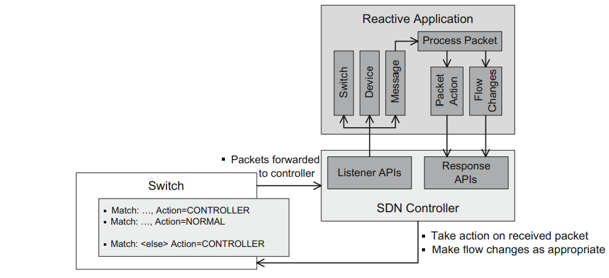
Reactive Application Design

Slide 12
Reactive Application Design
Controller has a listener interface that allows the application to provide listeners for switch, device, and message (incoming packet) events.
Typically, a reactive application will have a module to handle packets incoming to the controller that have been forwarded through the message listener.
This packet processing can then act on the packet.
Typical actions include returning the request to the switch, telling it what to do with the packet (e.g., forward out a specific port, forward NORMAL or drop the packet).
Other actions taken by the application can involve setting flows on the switch in response to the received packet, which will inform the switch what to do the next time it sees a packet of this nature.
For reactive applications, the last flow entry will normally be programmed to match any packet and to direct the switch to forward that otherwise unmatched packet to the controller.
This methodology is precisely what makes the application reactive.

Slide 13
Reactive Application Design
When a packet not matching any existing rule is encountered, it is forwarded to the controller so that the controller can react to it via some appropriate action.
A packet may also be forwarded to the controller in the event that it matches a flow entry and the associated action stipulates that the packet be passed to the controller.
In the reactive model, the flow tables tend to continually evolve based on the packets being processed by the switch and by flows aging out.

Slide 14
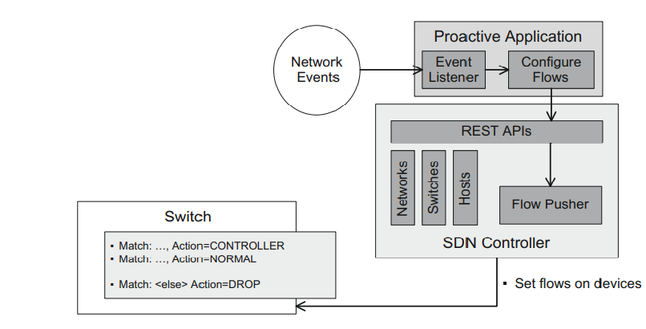
Proactive Application Design

Slide 15
Proactive Application Design
In such an application no listeners are receiving from the controller events about switches, devices, and messages.
Such listeners are not a natural fit with a one-way RESTful API, wherein the application makes periodic calls to the API and the API has no means of initiating communication back to the application.
As shown in Figure, proactive applications rely on stimulus from external network events.
Such stimuli may originate from a number of sources, such as traffic or switch monitors using SNMP or SNORT, or external applications like a server virtualization service, which notifies the application of the movement of a virtual machine from one physical server to another.
The RESTful APIs are still able to retrieve data about the network, such as domains, subnets, switches, and hosts.
RESTful APIs generally also provide an interface, often referred to as a flow pusher, which allows the application to set flows on switches.
Thus the proactive application has the same ability to program flows as the reactive application but will tend to use wildcard matches more frequently.

Slide 16
Proactive Application Design
The last flow entry will typically be to DROP unmatched packets.
This is because proactive applications attempt to anticipate all traffic and program flow entries accordingly.
As a consequence, packets that do not match the configured set of rules are discarded.
The match criteria for flow entries can be programmed such that most arriving packet types are expected and match some entry before this final DROP entry.
If this were not the case, the purely proactive model could become an expensive exercise in dropping packets!

Slide 17
Hybrid Reactive - Proactive Applications
There will be hybrid reactive-proactive applications that utilize a language such as Java for listeners and communicate via some external means to the proactive part of the application.
The proactive component would then program new flow entries on the switch.
As applications become more complex, this hybrid model is likely to become more common.
The comment made previously about arriving packets in a proactive application matching some flow entry before the final DROP entry is also germane to the case of hybrid applications.
The proactive part of such hybrid applications will have programmed higher-priority flow entries so that only a reasonable number of packets match the final DROP entry.
In such a hybrid model, the final entry will send all unmatched packets to the controller, so it is important to limit this number to a rate that the controller can handle.

Slide 18
Analyzing Simple SDN Applications
Proactive, RESTful-based applications can run either on the same system as the controller or on a remote system, since HTTP allows that flexibility.
In contrast, reactive applications are tightly bound to the controller as they access the controller via the native APIs (e.g., Java or C), and they run in the same container or execution space.
The application examples we provide use the Floodlight controller, one of the most popular open source SDN controllers.
It is possible to download the source code and examine the details of the controller itself.
Floodlight also comes with a number of sample applications, such as a learning switch and a load balancer, which provide excellent additional examples.
The core modules of the Floodlight controller come from the seminal Beacon controller.
These components are denoted as org.openflow packages within the Floodlight source code.

